Slide 1
Основы языка программирования Python
Аннотации типов

Slide 2
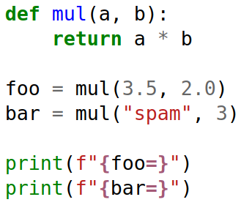


Slide 3
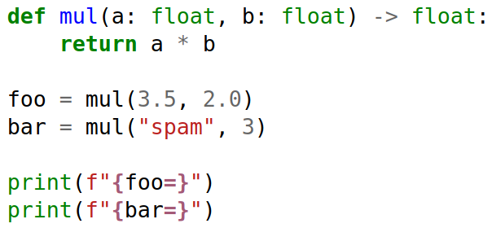
src/11. Typing/example_typing_01.py

Slide 4
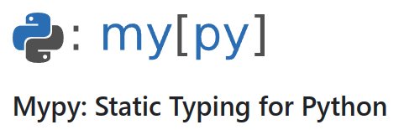
Mypy
https://mypy-lang.org
https://github.com/python/mypy
Mypy is an optional static type checker for Python that aims to combine the benefits of dynamic (or "duck") typing and static typing. Mypy combines the expressive power and convenience of Python with a powerful type system and compile-time type checking. Mypy type checks standard Python programs; run them using any Python VM with basically no runtime overhead.

Slide 5
Пример использования Mypy
> mypy example_typing_01.py
example_typing_01.py:5: error: Argument 1 to "mul" has incompatible type "str"; expected "float" [arg-type]
Found 1 error in 1 file (checked 1 source file)

Slide 6
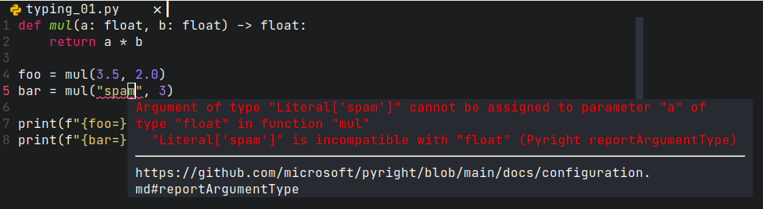

Slide 7
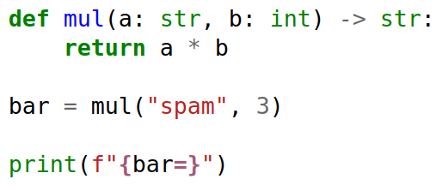
src/11. Typing/example_typing_02.py

Slide 8
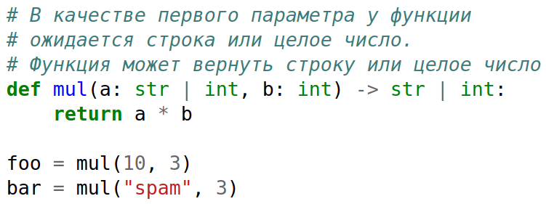
src/11. Typing/example_typing_03.py

Slide 9
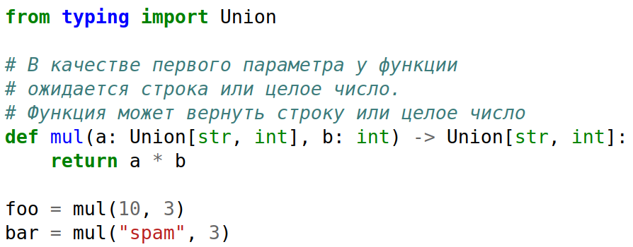
src/11. Typing/example_typing_04.py

Slide 10
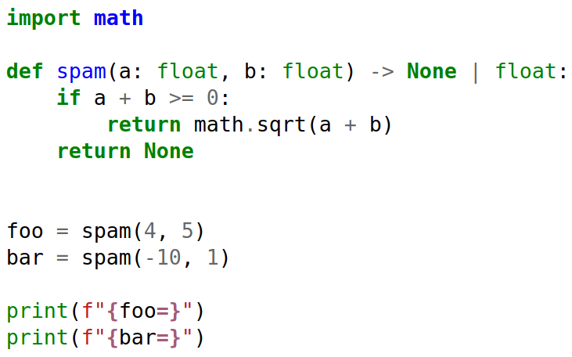

src/11. Typing/example_typing_05.py

Slide 11
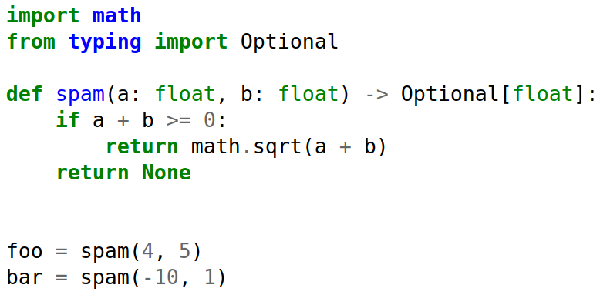
src/11. Typing/example_typing_06.py

Slide 12
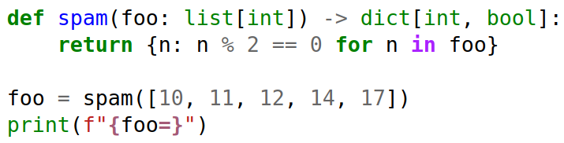
src/11. Typing/example_typing_07.py

Slide 13
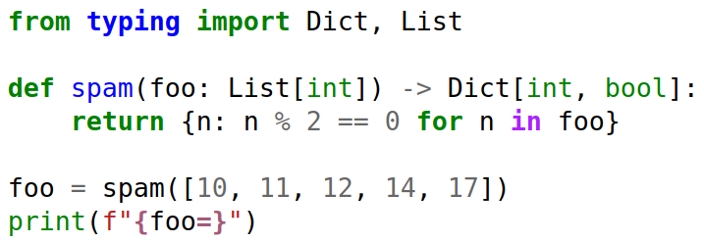
src/11. Typing/example_typing_08.py

Slide 14
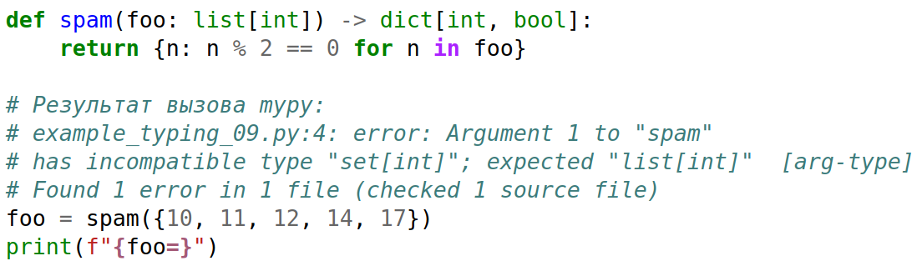
src/11. Typing/example_typing_09.py

Slide 15
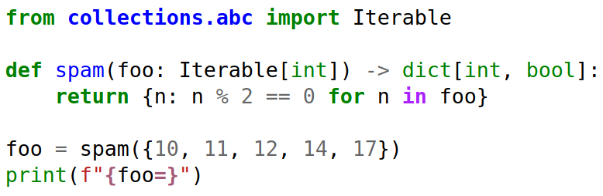
src/11. Typing/example_typing_10.py

